Slide 1
SUPPORT VECTOR MACHINES

Slide 2
Typical Data Science Cycle
Data Collection
Business Insights & Understanding
Data Understanding
Model Building & Evaluation
Data Pre-Processing

Slide 3
Machine Learning
Supervised ML
(Target Variables)
Classification
Regression
Linear Regression (Causal) , Decision Tree,Random Forest, Boosting, Neural Network,SVM
Logistic Regression , Decision Tree, ,Random Forest, Boosting, Neural Network,SVM

Slide 4
Introduction
Ideation

Slide 5
Introduction
SVM (support vector machine) is a supervised ML algorithm.
SVM model is a representation of the examples as points in space, mapped so that the examples of the separate categories are divided by a clear gap that is as wide as possible.
Support-vector machine constructs a line or hyperplane in a high or infinite-dimensional space.
SVMs can efficiently perform a non-linear classification using what is called the kernel trick.
It is applicable for classification and regression.
Notes:
https://towardsdatascience.com/https-medium-com-pupalerushikesh-svm-f4b42800e989

Slide 6
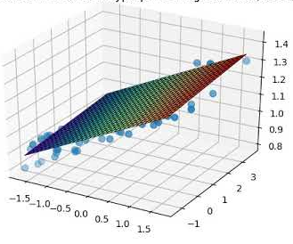
How SVM Works
Identify target variable and independent variables.
SVM comes up with an imaginary Hyper-Plane that splits the data into target outputs.
If we have p-dimensional space, a hyperplane is a flat subspace with dimension p-1.
e.g. For three-dimensional space, a hyperplane is a two-dimensional subspace.
e.g. For 2 dimensional data a line will be hyperplane.
Notes:
https://www.analyticsvidhya.com/blog/2017/09/understaing-support-vector-machine-example-code/
https://towardsdatascience.com/https-medium-com-pupalerushikesh-svm-f4b42800e989

Slide 7
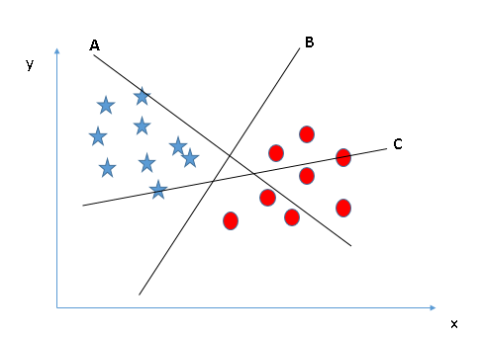
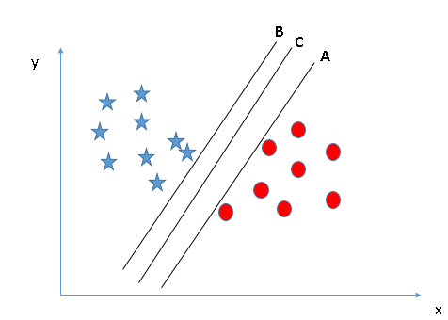
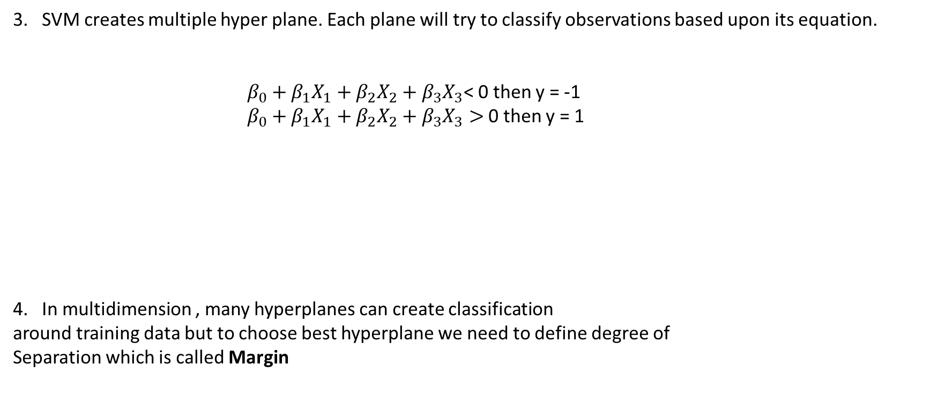
How SVM Works
3. SVM creates multiple hyper plane. Each plane will try to classify observations based upon its equation.
$β_{0}+β_{1}X_{1}+β_{2}X_{2}+β_{3}X_{3}$< 0 then y = -1
$β_{0}+β_{1}X_{1}+β_{2}X_{2}+β_{3}X_{3}>$ 0 then y = 1
4. In multidimension , many hyperplanes can create classification
around training data but to choose best hyperplane we need to define degree of
Separation which is called Margin
Notes:
https://www.analyticsvidhya.com/blog/2017/09/understaing-support-vector-machine-example-code/
https://towardsdatascience.com/support-vector-machine-support-vector-classifier-maximal-margin-classifier-22648a38ad9c

Slide 8
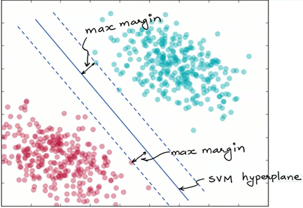
How SVM Works
Distance of closest points of separate classes around
individual hyperplane is calculated. This is called margin.
Best hyper plane will have maximum margin around nearest training data points. This Plane is also called maximal margin classifier . It contains two lines called margin lines, each on one and other side of that plane.
Notes:
https://www.analyticsvidhya.com/blog/2017/09/understaing-support-vector-machine-example-code/
https://towardsdatascience.com/support-vector-machine-support-vector-classifier-maximal-margin-classifier-22648a38ad9c
https://www.youtube.com/watch?v=pq88UFYJ2PA

Slide 9
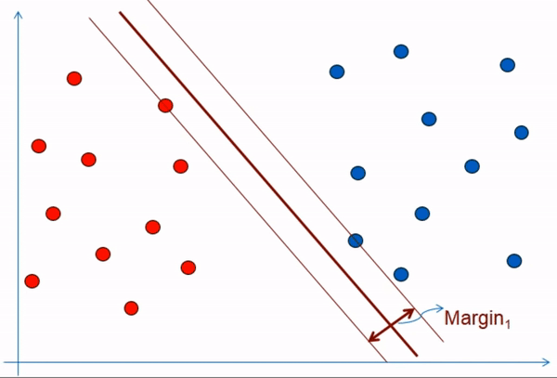
How SVM Works
Notes:
https://miro.medium.com/max/1200/1*fYXRn8T4u-BTGxFelpC2yg.gif

Slide 10
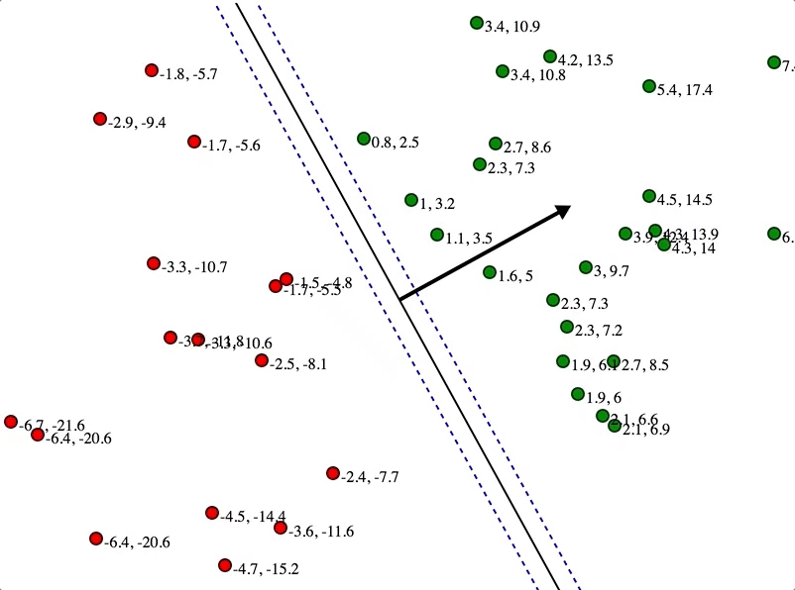
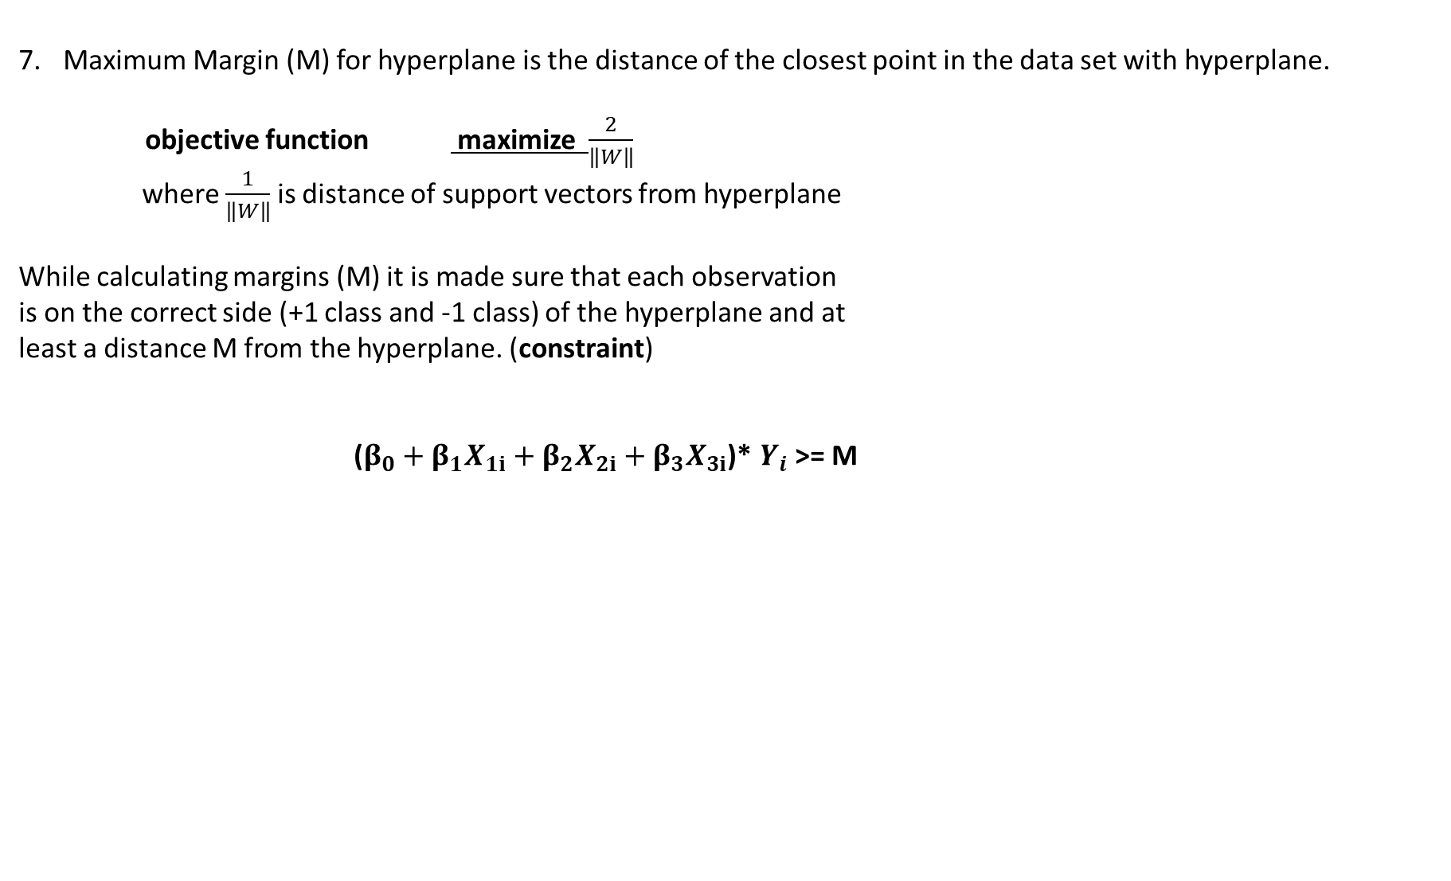
How SVM Works
Maximum Margin (M) for hyperplane is the distance of the closest point in the data set with hyperplane.
objective function maximize $\frac{2}{\left\|W\right\|}$
where $\frac{1}{\left\|W\right\|}$ is distance of support vectors from hyperplane
While calculating margins (M) it is made sure that each observation
is on the correct side (+1 class and -1 class) of the hyperplane and at
least a distance M from the hyperplane. (constraint)
($β_{0}+β_{1}X_{1i}+β_{2}X_{2i}+β_{3}X_{3i}$)* $Y_{i}$ >= M
Notes:
https://www.analyticsvidhya.com/blog/2017/09/understaing-support-vector-machine-example-code/
https://towardsdatascience.com/support-vector-machine-support-vector-classifier-maximal-margin-classifier-22648a38ad9c
https://www.youtube.com/watch?v=pq88UFYJ2PA
https://jeremykun.files.wordpress.com/2017/06/svm_solve_by_hand-e1496076457793.gif
https://www.sciencedirect.com/topics/computer-science/separating-hyperplane

Slide 11
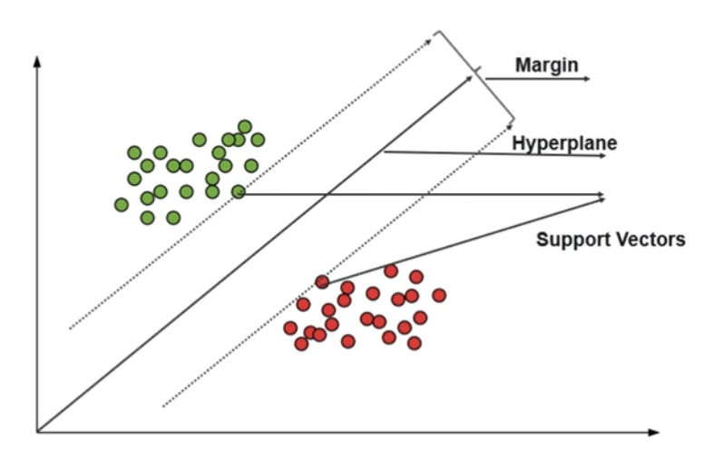
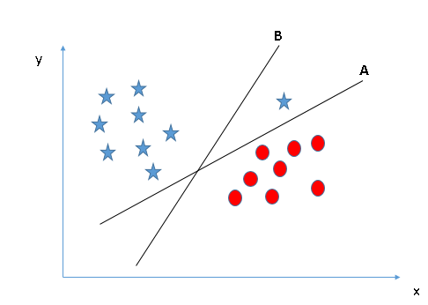
How SVM Works
8. Support Vectors are simply the coordinates of closest observation (lying on margin
lines). They define the length of maximal margin. These affect the position and orientation
of the hyper-plane. We have to select a hyperplane, for which the margin, i.e the
distance between support vectors and hyper-plane is maximum. Even a little
interference in the position of these support vectors can change the hyper-plane.
9. Apart from selecting maximum margin, we need to consider minimum
misclassification error. Although hyperplane B has higher margin but right
Hyperplane is A because it has classified all samples correctly. SVM selects
the hyper-plane which classifies the classes accurately prior to maximizing margin.
Notes:
https://www.analyticsvidhya.com/blog/2017/09/understaing-support-vector-machine-example-code/
https://towardsdatascience.com/support-vector-machine-support-vector-classifier-maximal-margin-classifier-22648a38ad9c

Slide 12
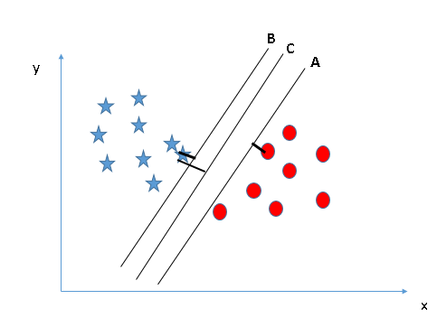
How SVM Works
1. MULTIPLE HYPERPLANES
2. HYPERPLANES CLASSIFYING POINTS SUCCESSFULLY
3. SELECTED HYPERPLANE based on margin
4. MISCLASSIFICATION HYPERPLANE

Slide 13
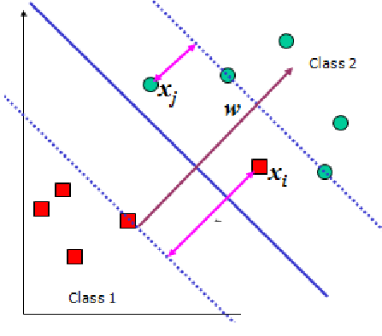
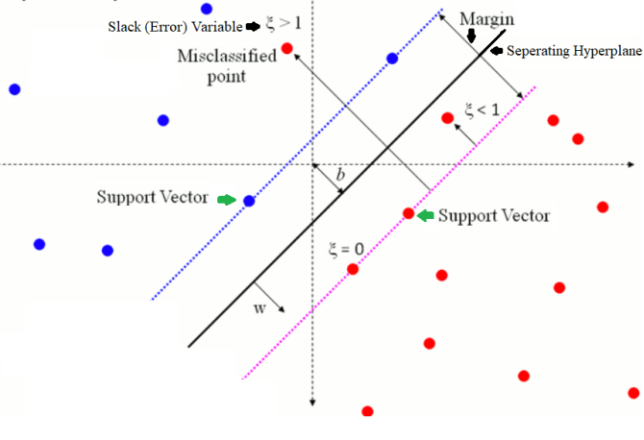
Soft margin SVM
If data is overlapping and hard to separate linearly then allow SVM to make a certain number
of mistakes (i.e. margin violation) keeping margin as wide as possible so that other points can still be
classified correctly. This is called soft margin.
Sample violating
margins
This can be done simply by modifying the constraint of objective function of SVM.
Notes:
https://towardsdatascience.com/support-vector-machines-soft-margin-formulation-and-kernel-trick-4c9729dc8efe

Slide 14
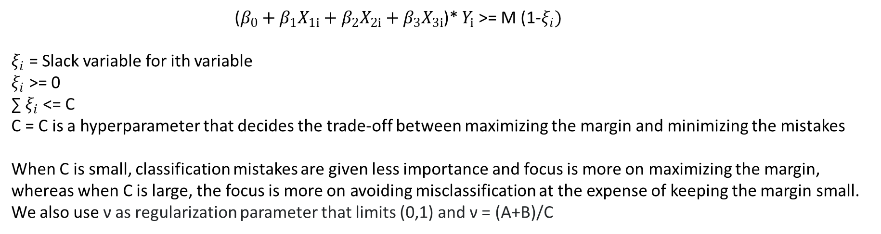
Soft margin SVM
($β_{0}+β_{1}X_{1i}+β_{2}X_{2i}+β_{3}X_{3i}$)* $Y_{i}$ >= M (1-$ξ_{i})$
$ξ_{i}$ = Slack variable for ith variable
$ξ_{i}$ >= 0
∑ $ξ_{i}$ <= C
C = C is a hyperparameter that decides the trade-off between maximizing the margin and minimizing the mistakes
When C is small, classification mistakes are given less importance and focus is more on maximizing the margin, whereas when C is large, the focus is more on avoiding misclassification at the expense of keeping the margin small. We also use ν as regularization parameter that limits (0,1) and ν = (A+B)/C
Notes:
https://towardsdatascience.com/support-vector-machines-soft-margin-formulation-and-kernel-trick-4c9729dc8efe

Slide 15
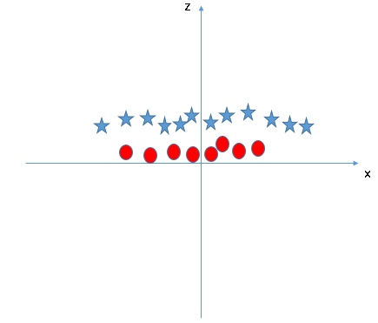
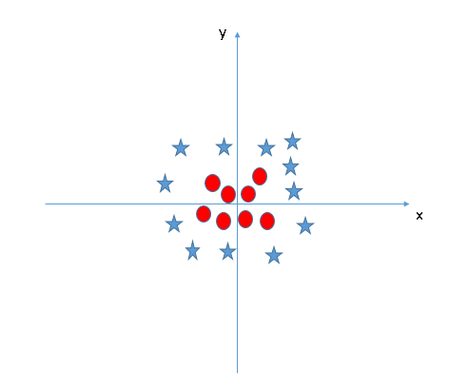
Kernels
WHAT IF POINTS ARE NOT LINEAR
A liner hyperplane cannot separate training observations belonging to two different classes.
POINTS
TRANSFORMATION
We can consider enlarging the feature space using functions of the predictors such as quadratic or cubic terms in order to address the non-linearity. E.g. we can convert 2 D data (x1,y1) , (x2,y2) into 3D data
(X1,Y1,Z1) and (X2,Y2,Z2).
Notes:
https://towardsdatascience.com/support-vector-machine-support-vector-classifier-maximal-margin-classifier-22648a38ad9c

Slide 16
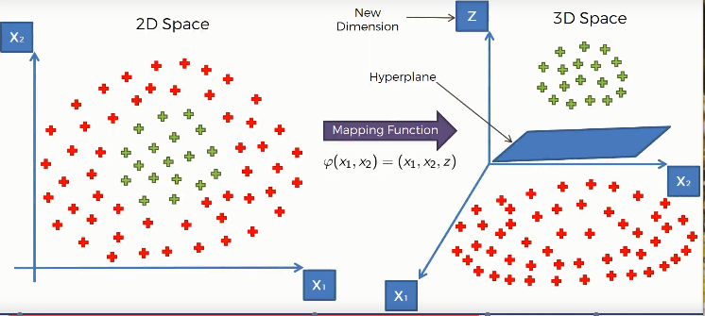
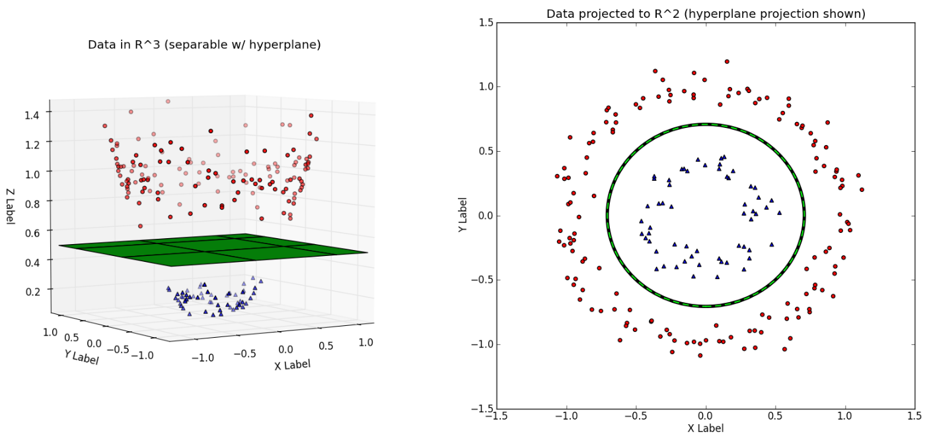
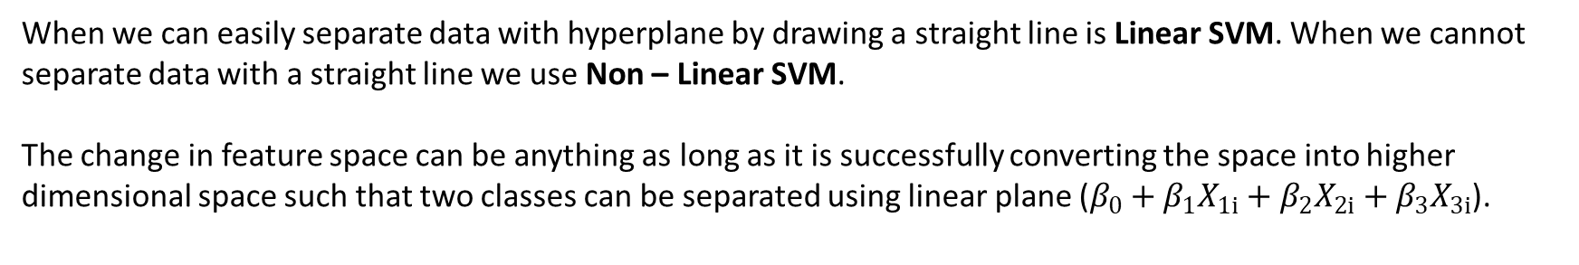
Kernels
When we can easily separate data with hyperplane by drawing a straight line is Linear SVM. When we cannot separate data with a straight line we use Non – Linear SVM.
The change in feature space can be anything as long as it is successfully converting the space into higher dimensional space such that two classes can be separated using linear plane ($β_{0}+β_{1}X_{1i}+β_{2}X_{2i}+β_{3}X_{3i}$).
Notes:
https://www.analyticsvidhya.com/blog/2021/06/support-vector-machine-better-understanding/
https://towardsdatascience.com/support-vector-machine-support-vector-classifier-maximal-margin-classifier-22648a38ad9c
https://www.aitude.com/svm-difference-between-linear-and-non-linear-models/
https://www.youtube.com/watch?v=ikt7Qze0czE

Slide 17

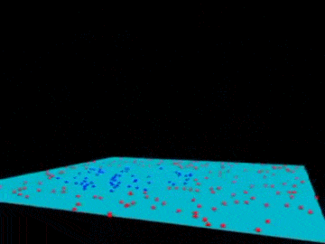
Kernels
Notes:
https://www.analyticsvidhya.com/blog/2021/06/support-vector-machine-better-understanding/
https://towardsdatascience.com/support-vector-machine-support-vector-classifier-maximal-margin-classifier-22648a38ad9c
https://www.aitude.com/svm-difference-between-linear-and-non-linear-models/
https://www.youtube.com/watch?v=ikt7Qze0czE

Slide 18
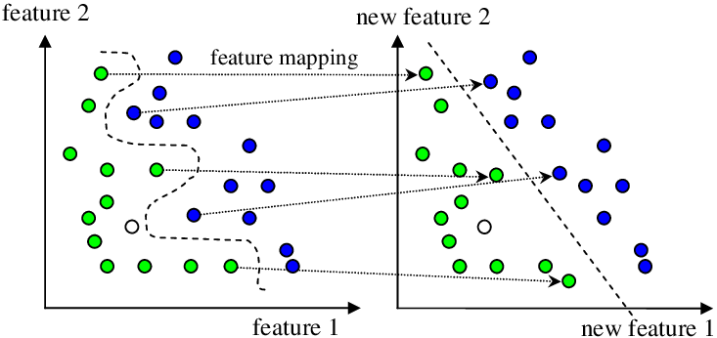
Kernels
In SVM, The kernel trick is an effective approach for enlarging the feature space.
X1, X2 X1,X2, X1`, X2`,X3`,X4`
The SVM kernel is a function that takes low dimensional input space and transforms it to a higher dimensional space
Kernel
Transformation
Kernel Transformation
Notes:
https://www.analyticsvidhya.com/blog/2021/06/support-vector-machine-better-understanding/

Slide 19
How SVM Works
Most of the common Kernels available are:
Linear Kernel : The decision boundary is a straight line. Unfortunately, most of the real-world data is not linearly separable, this is the reason the linear kernel is not widely used in SVM. Mostly preferred for text classification.
f(x) = sum(xi,xj)
(Or dot poduct of two observations xi.xj)
Polynomial Kernel :
K(xi,xj) = (1 + (xi * xj))^d
Sum of dot product between input observation (xi,xj) in training data.
This shows high dimensional relationship for xi and xj using Polynomial kernel and also this decides the decision boundary to separate the given classes.
Notes:
https://dataaspirant.com/svm-kernels/
https://medium.com/machine-learning-101/chapter-2-svm-support-vector-machine-theory-f0812effc72
https://www.youtube.com/watch?v=OKFMZQyDROI
https://www.youtube.com/watch?v=Toet3EiSFcM&t=56s
https://data-flair.training/blogs/svm-kernel-functions/

Slide 20
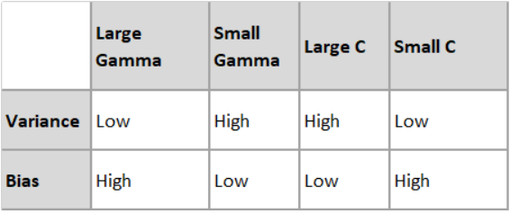
How SVM Works
Gaussian Radial basis function kernel (RBF)
K(xi,xj) = exp(-gamma * ((xi — xj)²)
Gamma determines the influence of training observations to classify new observation. The value of gamma varies from 0 to 1
Time of SVM learning: linear < poly < rbf
Ability to fit any data: linear < poly < rbf
Risk of overfitting: linear < poly < rbf
Risk of underfitting: rbf < poly < linear
we should start with linear kernel and try other kernels
if performance is not good.
Notes:
https://stackoverflow.com/questions/33778297/support-vector-machine-kernel-types
https://www.analyticsvidhya.com/blog/2021/06/support-vector-machine-better-understanding/
https://www.quora.com/Why-does-RBF-kernel-generally-outperforms-linear-or-polynomial-kernels?utm_medium=organic&utm_source=google_rich_qa&utm_campaign=google_rich_qa

Slide 21
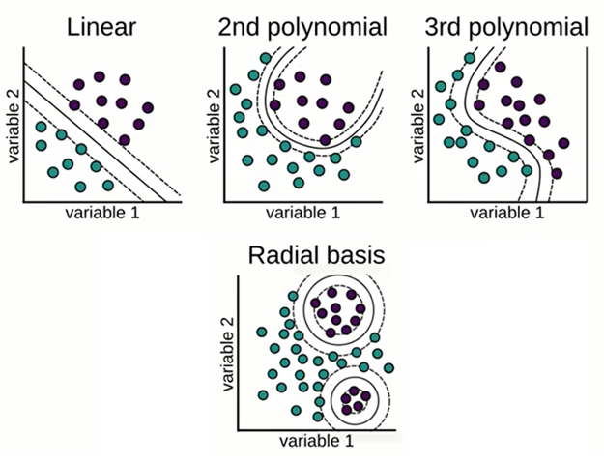
How SVM Works
Time of SVM learning: linear < poly < rbf
Ability to fit any data: linear < poly < rbf
Risk of overfitting: linear < poly < rbf
Risk of underfitting: rbf < poly < linear
we should start with linear kernel and try other kernels
if performance is not good.
Notes:
https://www.youtube.com/watch?v=0QNXhZKwUII
https://stackoverflow.com/questions/33778297/support-vector-machine-kernel-types
https://www.analyticsvidhya.com/blog/2021/06/support-vector-machine-better-understanding/
https://www.quora.com/Why-does-RBF-kernel-generally-outperforms-linear-or-polynomial-kernels?utm_medium=organic&utm_source=google_rich_qa&utm_campaign=google_rich_qa

Slide 22
Demo
https://jgreitemann.github.io/svm-demo

Slide 23
Hyper parameter Tuning
C float, default=1.0
Regularization parameter. The strength of the regularization is inversely proportional to C. Must be strictly positive. The penalty is a squared l2 penalty.
kernel{‘linear’, ‘poly’, ‘rbf’, ‘sigmoid’, ‘precomputed’}, default=’rbf’
Specifies the kernel type to be used in the algorithm. It must be one of ‘linear’, ‘poly’, ‘rbf’, ‘sigmoid’, ‘precomputed’ or a callable. If none is given, ‘rbf’ will be used.
Degree int, default=3
Degree of the polynomial kernel function (‘poly’). Ignored by all other kernels.
gamma{‘scale’, ‘auto’} or float, default=’scale’
Kernel coefficient for ‘rbf’, ‘poly’ and ‘sigmoid’.
if gamma='scale' (default) is passed then it uses 1 / (n_features * X.var()) as value of gamma,
if ‘auto’, uses 1 / n_features.

Slide 24
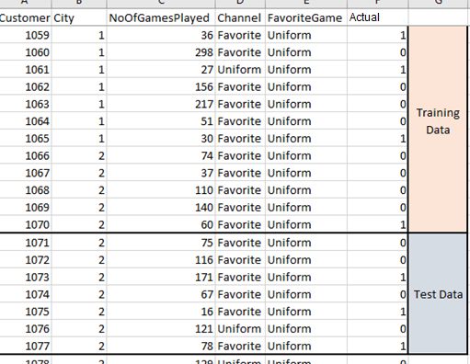
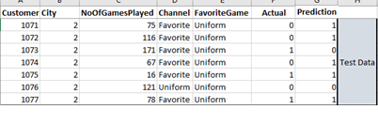
Performance Validation
Performance validation of SVM
Modelling on Training Data
ML Model
Apply on Test Data
Prediction

